Slide 1

HBase at China Telecom
Chen Ze

Slide 2
Content
01
Infrastructure & Application
HBase usage at China Telecom
02
Monitor & Optimization
How do we monitor HBase and optimization
03
Q&A

Slide 3
Infrastructure & Application
01
HBase usage at China Telecom

Slide 4
Infrastructure
Telecom Open platform
Ad-hoc
ETL development
job scheduling
Cluster managerment
Monitor & Alert
……
YARN
Tachyon
Zookeeper
Offline computing platform
Real-time computation platform
Kerberos
Mahout
Hive
Pig
HDFS
SQL
MLlib
MapReduce
Impala
Storm
Spark Streaming
Tez
Spark
HBase
Elasticsearch
Sqoop
DataX
Data collecting
Data exchange
Flume
FTP
Notes:
Ad hoc 即席查询

Slide 5
China Telecom HBase Platform
322 hosts in a independent HDFS cluster ,32 cores，256GB memory，3.6T*12 disk
6 HBase clusters with different kinds of application
Persistence for Streaming Jobs
Online writing/reading
Kylin support
520 TB data ，1 TB/day
HBase1.2.0--CDH 5.12.1

Slide 6
Persistence for Streaming Jobs
core system
data collecting system

Slide 7
Data collecting system
Collect different kinds of data with different kinds of collecting method
Collecting system
real-time data
CRM/VSOP
CRM /VSOP
DPI/signal/CDR
OSS
Quasi-real-time data
Core system
MSS
DPI/signal/CDR
accounts data
OSS
accounts data
batch data
…
MSS

Slide 8
Data collecting system
OSS data collecting use HBase replication to receive data from 31 Provincial branches
Provincial branches
Shanghai data center
HBase
HBase
replication
HBase
HDFS
HBase

Slide 9
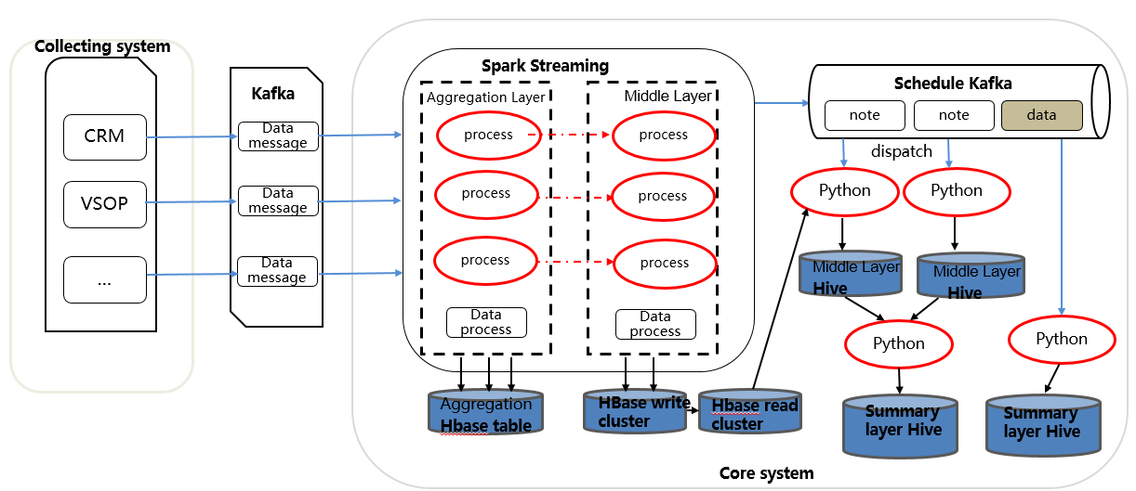
Core System
core system use HBase to store middle layer data and Aggregation layer data through Spark Streaming

Slide 10
Online writing/reading application
DPI data service
Location-based data service

Slide 11
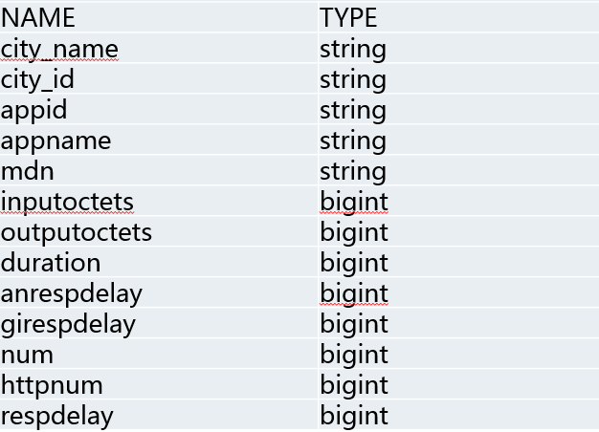
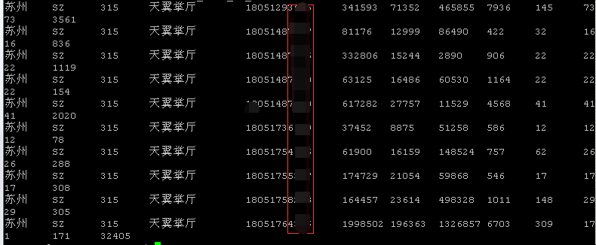
DPI data service
What is DPI data?

Slide 12
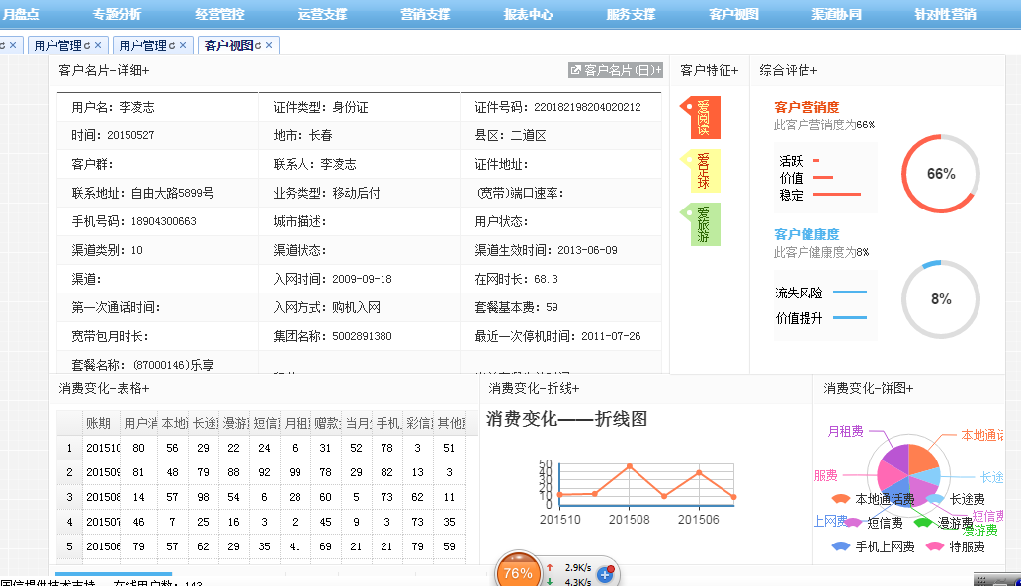
DPI data service
How to use DPI data ?

Slide 13
Location-based data service

Slide 14
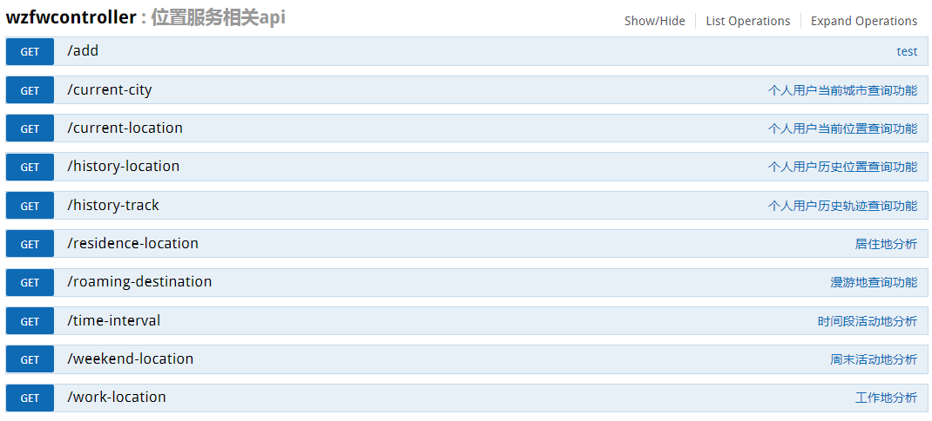
Location-based data service

Slide 15
Monitor & Optimization
02
How do we monitor HBase and optimization

Slide 16
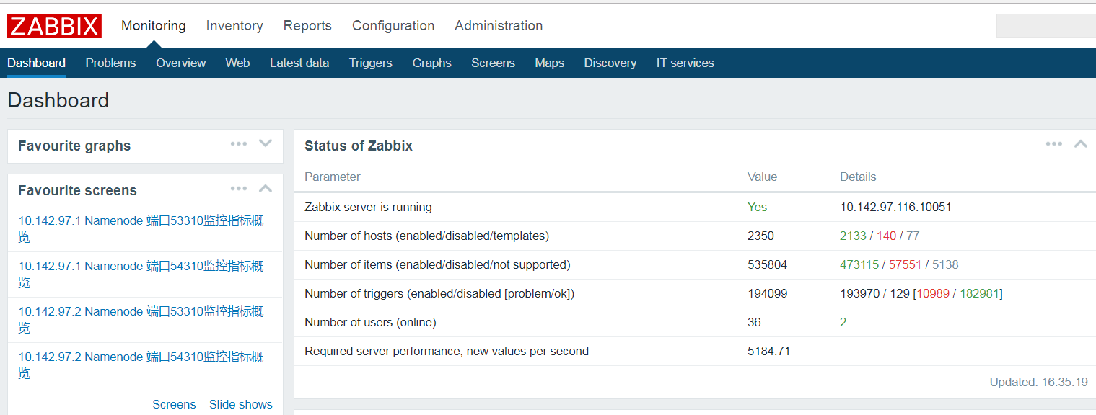
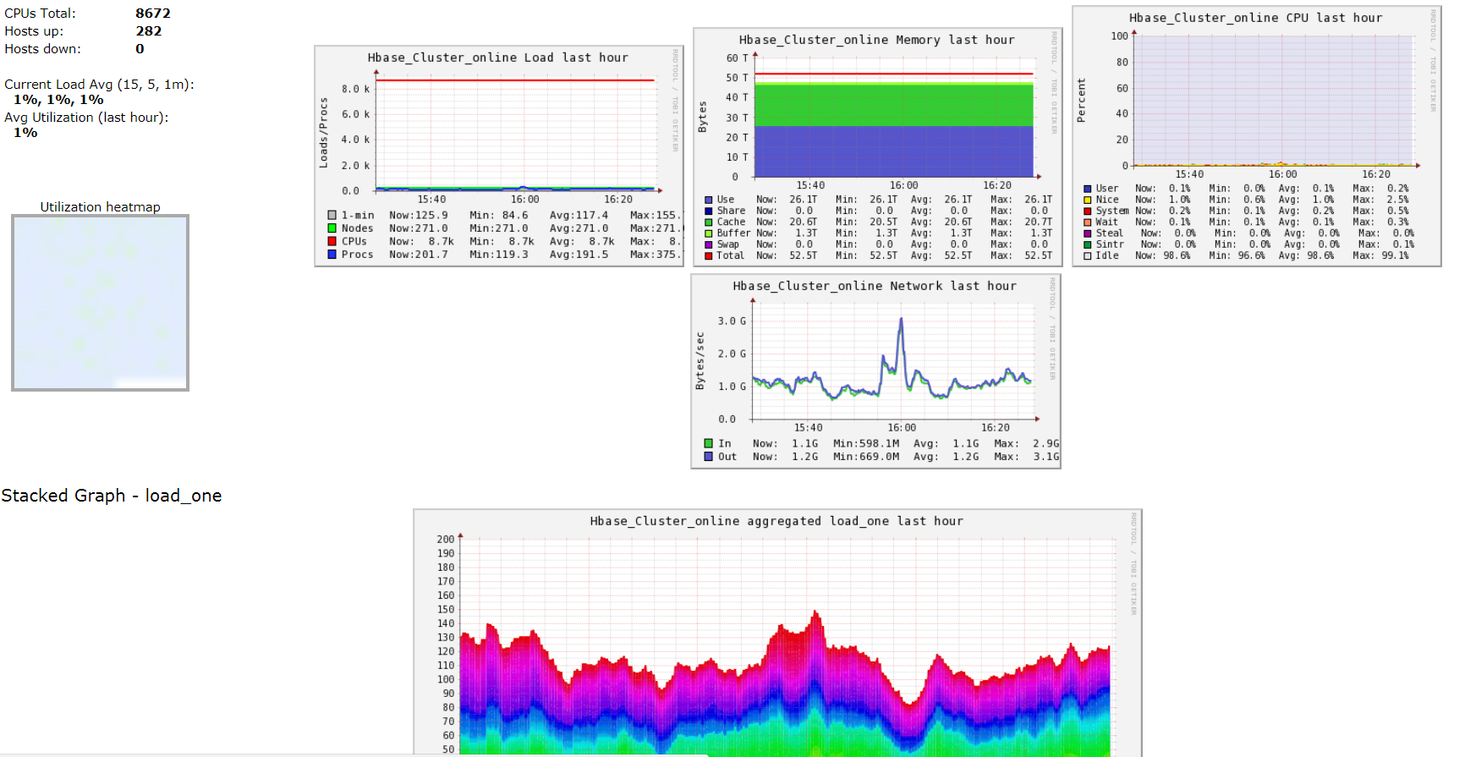
HBase Monitor
Tools
ganglia-3.6.0
Zabbix-3.2.4
Ganglia for HBase basic metrics
Zabbix for important items to alert

Slide 17
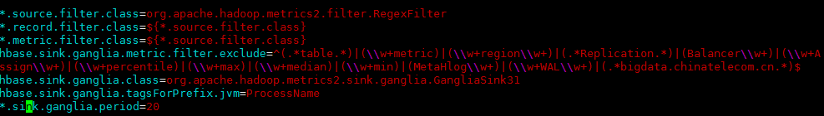
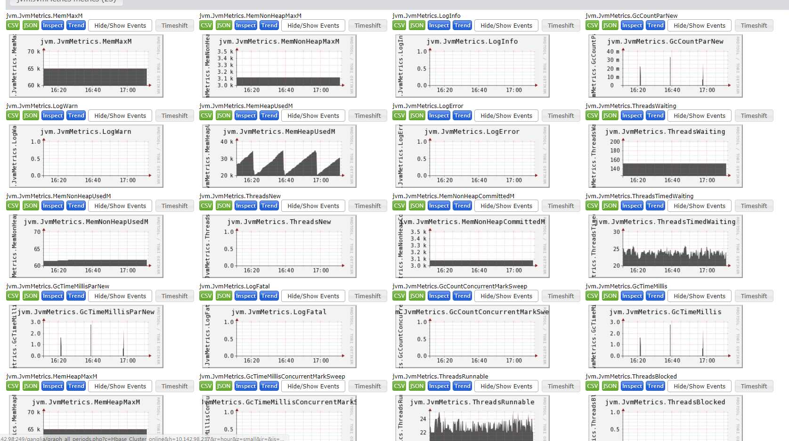
HBase ganglia configuration
Edit HBase config file hadoop-metrics2-hbase.properties
Than we can see many metrics items

Slide 18
Important metrics
Type | Items
System status | ping Available memory in percent Disk usage
HDFS status | NameNode port DataNode port JournalNode port HDFS avaliable space
HBase status | HBase Master Port HBase Region Server Port
Zookeeper status | ZooKeeper Port ZKFC Port
HBase RPC | regionserver.TotalCallTime regionserver.ProcessCallTime regionserver.QueueCallTime regionserver.numActiveHandler regionserver.ipc.numCallsInGeneralQueue regionserver.ipc.numOpenConnections regionserver.RegionServer.numCallsInWriteQueue regionserver.RegionServer.numCallsInReadQueue
Hbase IO | regionserver.Server.Mutate_99th_percentile regionserver.wal.SyncTime_99th_percentile regionserver.server.Get_99th_percentile regionserver.server.ScanTime_99th_percentile

Slide 19
Important metrics
Type | Items
HBase region | Region num,size BlockCache hit radio
JVM GC | jvm.JvmMetrics.GcTimeMillis jvm.JvmMetrics.GcCount GC log

Slide 20
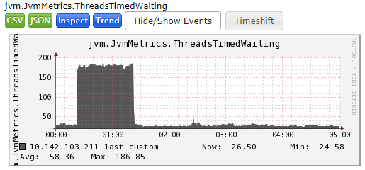
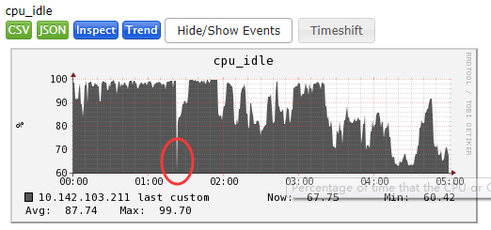
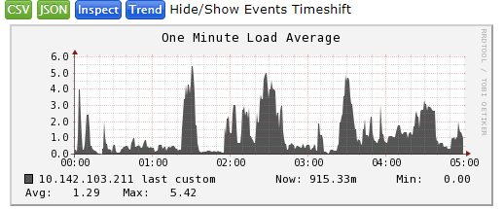
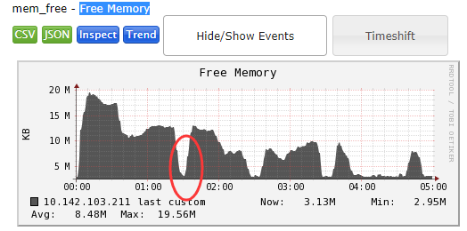
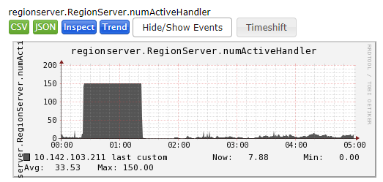
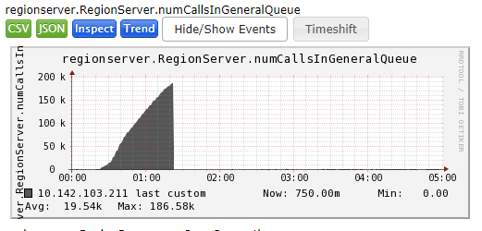
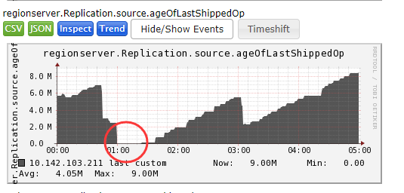
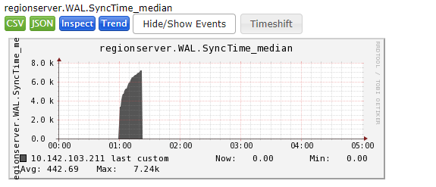

HBase Debug case
One day, our core data system hanged when trying to connection Hbase cluster…

Slide 21
HBase Optimization
CMS vs G1
Read/Write Splitting and some Optimization

Slide 22
CMS vs G1
CMS to G1
Why?

Slide 23
Read/Write Splitting Optimization
Use replication
Use Kerberos
Optimization hbase.ipc

Slide 24
Q&A

Slide 25
Thanks

